Slide 1
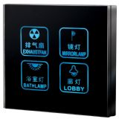
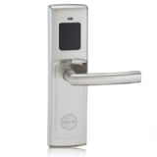
Topic1 -
Digital Lock - NXP Mifare Card Reader
Part#:MFRC522
LPC1112FBD48/202

